Slide 1


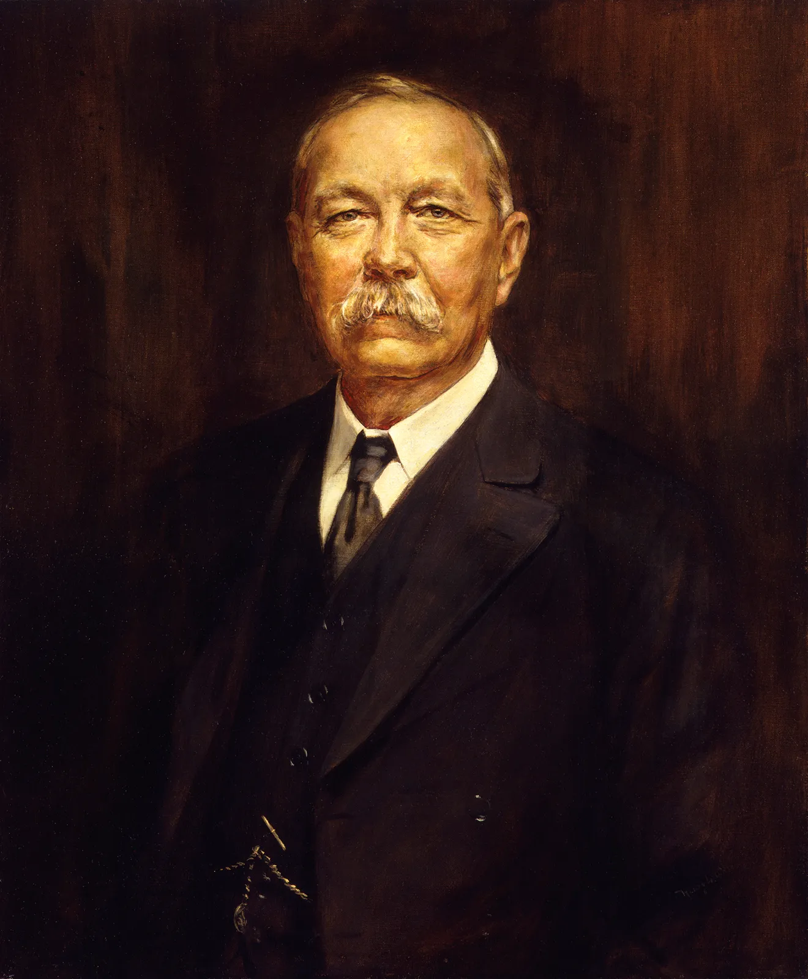
The Adventure of the Dying Detective
Deception and
Moral Ambiguity
Character Analysis
Sir Arthur Conan Doyle
Sherlock Holmes – A master of disguise and deception, Holmes manipulates both friend and foe to achieve his goal. His unwavering commitment to justice justifies his morally ambiguous methods. He appears frail and delirious but is, in reality, in complete control of the situation.
Dr. John Watson – Loyal and compassionate, Watson is genuinely distressed at Holmes' condition. His unwavering trust in Holmes is tested, yet he remains by his side. His character highlights the contrast between moral clarity and ethical dilemmas.
Culverton Smith – A cunning and ruthless man, Smith embodies deception for malevolent purposes. He believes himself untouchable but ultimately falls into Holmes’ trap, proving that deception can be outwitted by greater intelligence.
Mrs. Hudson – Though a minor character, Mrs. Hudson provides a crucial moment of emotional intensity. Her genuine distress makes Holmes’ deception even more impactful, adding realism to the act.
Sir Arthur Conan Doyle (1859–1930) was a British writer and physician, best known for creating the iconic detective Sherlock Holmes. His works revolutionized detective fiction, emphasizing logical deduction, forensic science, and acute observation. The Holmes stories, narrated by Dr. John Watson, depict thrilling mysteries solved with intellect and strategy.

Slide 2
The Adventure of the Dying Detective
Sir Arthur Conan Doyle
Sir Arthur Conan Doyle (1859–1930) was a British writer and physician, best known for creating the iconic detective Sherlock Holmes. His works revolutionized detective fiction, emphasizing logical deduction, forensic science, and acute observation. The Holmes stories, narrated by Dr. John Watson, depict thrilling mysteries solved with intellect and strategy.
Deception and
Moral Ambiguity
Character Analysis
Sherlock Holmes – A master of disguise and deception, Holmes manipulates both friend and foe to achieve his goal. His unwavering commitment to justice justifies his morally ambiguous methods. He appears frail and delirious but is, in reality, in complete control of the situation.
Dr. John Watson – Loyal and compassionate, Watson is genuinely distressed at Holmes' condition. His unwavering trust in Holmes is tested, yet he remains by his side. His character highlights the contrast between moral clarity and ethical dilemmas.
Culverton Smith – A cunning and ruthless man, Smith embodies deception for malevolent purposes. He believes himself untouchable but ultimately falls into Holmes’ trap, proving that deception can be outwitted by greater intelligence.
Mrs. Hudson – Though a minor character, Mrs. Hudson provides a crucial moment of emotional intensity. Her genuine distress makes Holmes’ deception even more impactful, adding realism to the act.

Slide 3
Character Analysis
Sir Arthur Conan Doyle
Sherlock Holmes – A master of disguise and deception, Holmes manipulates both friend and foe to achieve his goal. His unwavering commitment to justice justifies his morally ambiguous methods. He appears frail and delirious but is, in reality, in complete control of the situation.
Dr. John Watson – Loyal and compassionate, Watson is genuinely distressed at Holmes' condition. His unwavering trust in Holmes is tested, yet he remains by his side. His character highlights the contrast between moral clarity and ethical dilemmas.
Culverton Smith – A cunning and ruthless man, Smith embodies deception for malevolent purposes. He believes himself untouchable but ultimately falls into Holmes’ trap, proving that deception can be outwitted by greater intelligence.
Mrs. Hudson – Though a minor character, Mrs. Hudson provides a crucial moment of emotional intensity. Her genuine distress makes Holmes’ deception even more impactful, adding realism to the act.
Sir Arthur Conan Doyle (1859–1930) was a British writer and physician, best known for creating the iconic detective Sherlock Holmes. His works revolutionized detective fiction, emphasizing logical deduction, forensic science, and acute observation. The Holmes stories, narrated by Dr. John Watson, depict thrilling mysteries solved with intellect and strategy.
Summary of the Story
The story begins with Mrs. Hudson, Holmes’ landlady, desperately seeking Dr. Watson’s help, claiming that Holmes has been critically ill for three days. Upon arriving at 221B Baker Street, Watson finds Holmes in a terrible state—pale, weak, and delirious. Despite Watson’s insistence on examining him, Holmes refuses, claiming he is suffering from a rare and deadly tropical disease. He instructs Watson to fetch Culverton Smith, a specialist in such illnesses, warning Watson not to return too soon or alert Smith that Holmes has sent for him. Watson, deeply concerned, follows the instructions. Upon Smith’s arrival, Holmes appears to be at death’s door. Believing Holmes to be too weak to survive, Smith arrogantly confesses to infecting him, just as he had done to his own nephew, Victor Savage. At this moment, Holmes suddenly sits up, revealing that he was never sick at all. The entire act was a ruse to trick Smith into admitting his crime. Inspector Morton arrives just in time to arrest Smith, completing Holmes’ elaborate deception and proving, once again, that intellect and trickery can be as powerful as brute force in solving crimes.

Slide 4
Summary of the Story
Character Analysis
The story begins with Mrs. Hudson, Holmes’ landlady, desperately seeking Dr. Watson’s help, claiming that Holmes has been critically ill for three days. Upon arriving at 221B Baker Street, Watson finds Holmes in a terrible state—pale, weak, and delirious. Despite Watson’s insistence on examining him, Holmes refuses, claiming he is suffering from a rare and deadly tropical disease. He instructs Watson to fetch Culverton Smith, a specialist in such illnesses, warning Watson not to return too soon or alert Smith that Holmes has sent for him. Watson, deeply concerned, follows the instructions. Upon Smith’s arrival, Holmes appears to be at death’s door. Believing Holmes to be too weak to survive, Smith arrogantly confesses to infecting him, just as he had done to his own nephew, Victor Savage. At this moment, Holmes suddenly sits up, revealing that he was never sick at all. The entire act was a ruse to trick Smith into admitting his crime. Inspector Morton arrives just in time to arrest Smith, completing Holmes’ elaborate deception and proving, once again, that intellect and trickery can be as powerful as brute force in solving crimes.
Sherlock Holmes – A master of disguise and deception, Holmes manipulates both friend and foe to achieve his goal. His unwavering commitment to justice justifies his morally ambiguous methods. He appears frail and delirious but is, in reality, in complete control of the situation.
Dr. John Watson – Loyal and compassionate, Watson is genuinely distressed at Holmes' condition. His unwavering trust in Holmes is tested, yet he remains by his side. His character highlights the contrast between moral clarity and ethical dilemmas.
Culverton Smith – A cunning and ruthless man, Smith embodies deception for malevolent purposes. He believes himself untouchable but ultimately falls into Holmes’ trap, proving that deception can be outwitted by greater intelligence.
Mrs. Hudson – Though a minor character, Mrs. Hudson provides a crucial moment of emotional intensity. Her genuine distress makes Holmes’ deception even more impactful, adding realism to the act.
Deception and Moral Ambiguity
One of the central themes in this story is the use of deception as a tool for justice. Holmes’ strategy is undeniably effective, but it raises critical questions: Is it acceptable to lie and manipulate if the goal is to catch a criminal? This theme extends beyond literature into real-life ethical dilemmas in law enforcement, where undercover operations and psychological tactics are often employed to catch criminals. Additionally, the story explores the fine line between right and wrong—while Holmes uses deception for good, Smith uses it for evil. This contrast forces readers to consider whether morality is defined solely by intention or if the methods themselves matter just as much.

Slide 5
Summary of the Story
Deception and Moral Ambiguity
The story begins with Mrs. Hudson, Holmes’ landlady, desperately seeking Dr. Watson’s help, claiming that Holmes has been critically ill for three days. Upon arriving at 221B Baker Street, Watson finds Holmes in a terrible state—pale, weak, and delirious. Despite Watson’s insistence on examining him, Holmes refuses, claiming he is suffering from a rare and deadly tropical disease. He instructs Watson to fetch Culverton Smith, a specialist in such illnesses, warning Watson not to return too soon or alert Smith that Holmes has sent for him. Watson, deeply concerned, follows the instructions. Upon Smith’s arrival, Holmes appears to be at death’s door. Believing Holmes to be too weak to survive, Smith arrogantly confesses to infecting him, just as he had done to his own nephew, Victor Savage. At this moment, Holmes suddenly sits up, revealing that he was never sick at all. The entire act was a ruse to trick Smith into admitting his crime. Inspector Morton arrives just in time to arrest Smith, completing Holmes’ elaborate deception and proving, once again, that intellect and trickery can be as powerful as brute force in solving crimes.
One of the central themes in this story is the use of deception as a tool for justice. Holmes’ strategy is undeniably effective, but it raises critical questions: Is it acceptable to lie and manipulate if the goal is to catch a criminal? This theme extends beyond literature into real-life ethical dilemmas in law enforcement, where undercover operations and psychological tactics are often employed to catch criminals. Additionally, the story explores the fine line between right and wrong—while Holmes uses deception for good, Smith uses it for evil. This contrast forces readers to consider whether morality is defined solely by intention or if the methods themselves matter just as much.
Conclusion
The Adventure of the Dying Detective is a powerful exploration of the ethics of deception in crime-solving. Sherlock Holmes' actions prove that trickery can be a highly effective investigative tool, but they also highlight the potential moral cost of such methods. While his deception ultimately leads to the capture of a murderer, it comes at the price of trust — both Watson and Mrs. Hudson are left emotionally shaken by the ordeal. The story forces readers to question whether the pursuit of justice should come at any cost or if ethical boundaries should always be maintained. In the end, Holmes remains a heroic yet morally ambiguous figure, demonstrating that sometimes, solving a crime requires stepping into the grey areas of morality.

Slide 6
Deception and Moral Ambiguity
Conclusion
One of the central themes in this story is the use of deception as a tool for justice. Holmes’ strategy is undeniably effective, but it raises critical questions: Is it acceptable to lie and manipulate if the goal is to catch a criminal? This theme extends beyond literature into real-life ethical dilemmas in law enforcement, where undercover operations and psychological tactics are often employed to catch criminals. Additionally, the story explores the fine line between right and wrong—while Holmes uses deception for good, Smith uses it for evil. This contrast forces readers to consider whether morality is defined solely by intention or if the methods themselves matter just as much.
The Adventure of the Dying Detective is a powerful exploration of the ethics of deception in crime-solving. Sherlock Holmes' actions prove that trickery can be a highly effective investigative tool, but they also highlight the potential moral cost of such methods. While his deception ultimately leads to the capture of a murderer, it comes at the price of trust — both Watson and Mrs. Hudson are left emotionally shaken by the ordeal. The story forces readers to question whether the pursuit of justice should come at any cost or if ethical boundaries should always be maintained. In the end, Holmes remains a heroic yet morally ambiguous figure, demonstrating that sometimes, solving a crime requires stepping into the grey areas of morality.
Thank You

Slide 7
Conclusion
The Adventure of the Dying Detective is a powerful exploration of the ethics of deception in crime-solving. Sherlock Holmes' actions prove that trickery can be a highly effective investigative tool, but they also highlight the potential moral cost of such methods. While his deception ultimately leads to the capture of a murderer, it comes at the price of trust — both Watson and Mrs. Hudson are left emotionally shaken by the ordeal. The story forces readers to question whether the pursuit of justice should come at any cost or if ethical boundaries should always be maintained. In the end, Holmes remains a heroic yet morally ambiguous figure, demonstrating that sometimes, solving a crime requires stepping into the grey areas of morality.
Thank You

